Slide 1
Predict Patient Readmission (AIM CAPSTONE PROJECT) Kenneth P. Chua
https://www.kaggle.com/datasets/algozee/hospital-readmission-risk-prediction-2026

Slide 2
Content
Hospital Readmission Risk Prediction (2026) is a machine learning–based predictive analytics system designed to estimate the probability of a patient being readmitted within 30 days of hospital discharge. The project utilizes demographic data, clinical indicators, admission history, laboratory results, and medication-related features to build a robust predictive model. Advanced algorithms such as XGBoost and Gradient Boosting are applied to achieve high accuracy and reliable performance. The system aims to assist healthcare providers in identifying high-risk patients before discharge.
Context
Hospital readmissions represent a significant challenge in modern healthcare systems, contributing to increased operational costs and reduced quality of care. The 30-day readmission rate is widely recognized as a key healthcare performance indicator. By leveraging predictive analytics and machine learning, hospitals can proactively identify patients at high risk of readmission and implement targeted preventive interventions. This project reflects a 2026-level data-driven healthcare intelligence framework focused on improving patient outcomes and optimizing hospital resource management.
Problem Statement
Early identification of high-risk readmitted patients
Improved discharge planning and follow-up management
Reduction in avoidable 30-day hospital readmissions
Enhanced clinical decision-making through predictive analytics
Optimized hospital resource utilization and cost efficiency
Support for data-driven healthcare risk stratification
Contribution to AI-assisted hospital management systems
(https://www.kaggle.com/datasets/algozee/hospital-readmission-risk-prediction-2026)

Slide 3
Dataset
# | Column | Type
1 | Age | int64
2 | Gender | object
3 | Insurance_Type | object
4 | Socioeconomic_Risk_Score | int64
5 | Previous_Admissions_6M | int64
6 | Previous_Readmissions_1Y | int64
7 | Time_Since_Last_Discharge | int64
8 | Length_of_Stay | int64
9 | Admission_Type | object
10 | Primary_Diagnosis_Group | object
11 | Comorbidity_Index | int64
12 | Chronic_Disease_Count | int64
13 | ICU_Stay_Flag | int64
14 | Severity_Score | int64
15 | HbA1c_Level | float64
16 | Creatinine_Level | float64
17 | Hemoglobin_Level | float64
18 | Average_Systolic_BP | int64
19 | Number_of_Medications | int64
20 | Medication_Change_Count | int64
21 | High_Risk_Medication_Flag | int64
22 | Followup_Appointment_Scheduled | int64
23 | Discharge_Disposition | object
24 | Medication_Adherence_Score | float64
25 | Readmitted_Within_30_Days | int64

Slide 4
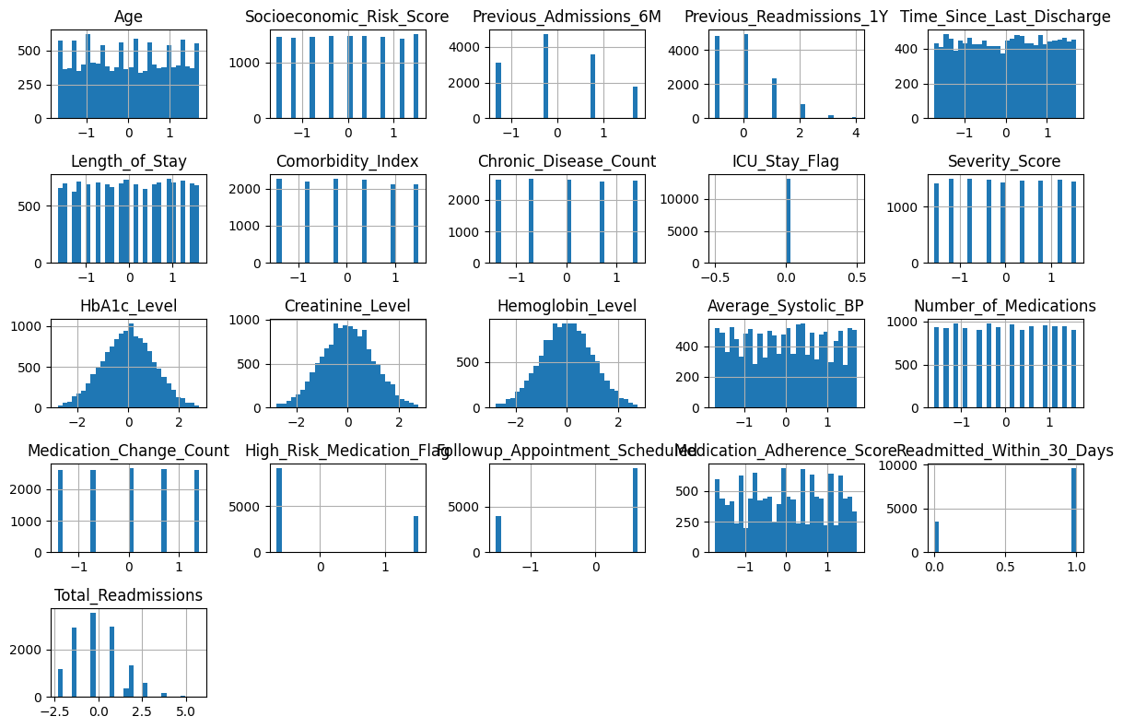
This image shows the distribution of various features in the dataset. These include clinical and socio-economic variables, such as: Age and Socioeconomic Risk Score: Both seem to have balanced distributions with a slight peak in the middle, indicating a normal distribution. Length of Stay, Comorbidity Index, and other clinical metrics like HbA1c Level and Creatinine Level are also visualized. Most variables show varied distributions with some skewed data (e.g., Severity Score and Medication Change Count). Readmission Status is heavily imbalanced, with most records indicating no readmission within 30 days, suggesting a need for addressing this imbalance in modeling.

Slide 5
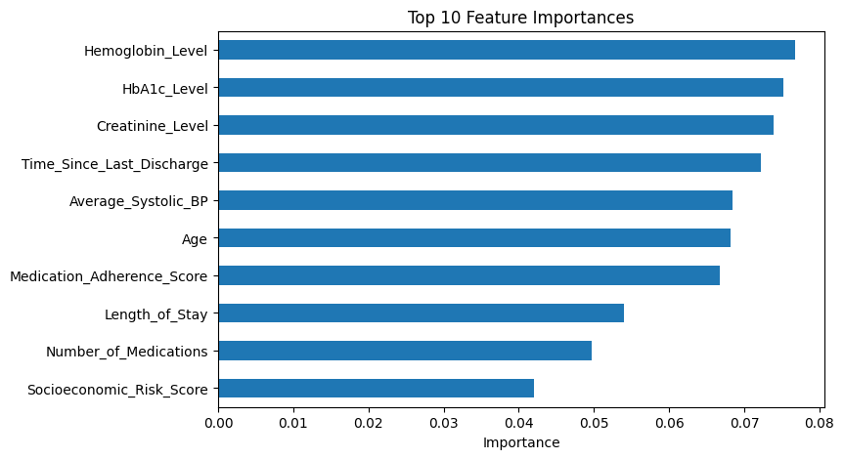
The bar chart of feature importances highlights the most influential variables in predicting readmissions:
Hemoglobin Level, HbA1c Level, and Creatinine Level are among the top features influencing readmission. These clinical indicators are critical markers for patients' health status and are commonly correlated with the risk of readmission.
Time Since Last Discharge and Average Systolic BP also show high importance, indicating that recency of the last hospital stay and blood pressure levels play significant roles in predicting readmission.
Age and Socioeconomic Risk Score appear further down but still show considerable importance. These factors underline the importance of patient demographics and socio-economic conditions in health outcomes.
The bar chart helps prioritize features that need to be monitored closely in predictive models and offers insight into which aspects of patient data most influence readmission risks.

Slide 6
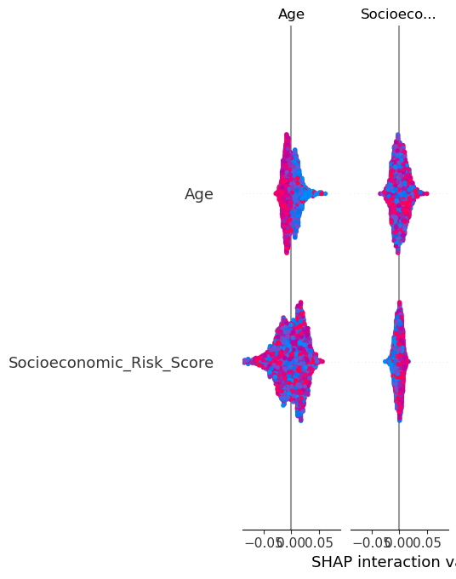
The SHAP interaction plot provides a visual representation of how features like Age and Socioeconomic Risk Score interact in the prediction of readmissions. This plot highlights:
The relationship between Socioeconomic Risk Score and Age in their impact on the prediction outcome.
Both features show strong interactions in the model, suggesting that individuals with specific age ranges and socioeconomic factors are more likely to be flagged for readmission.
The plot emphasizes how individual features influence the outcome, showing that as Age or Socioeconomic Risk Score changes, the probability of readmission varies.
This type of analysis helps in understanding the influence of these variables, particularly in terms of patient management and targeting high-risk individuals.

Slide 7
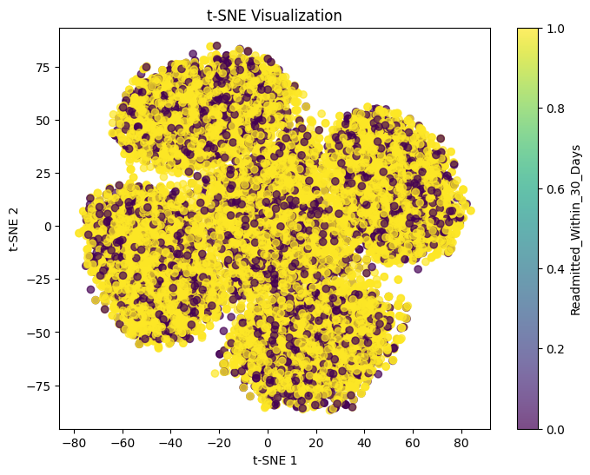
Cluster Density: The presence of denser clusters might suggest that patients with certain characteristics (such as similar health conditions or demographics) tend to have a higher likelihood of being readmitted within 30 days.
Separation: The t-SNE plot might indicate that the features used for dimensionality reduction are able to effectively separate patients into different groups based on their readmission risk. If there is a clear distinction between the yellow and purple points, it suggests that the model's features are useful in differentiating between readmitted and non-readmitted patients.

Slide 8
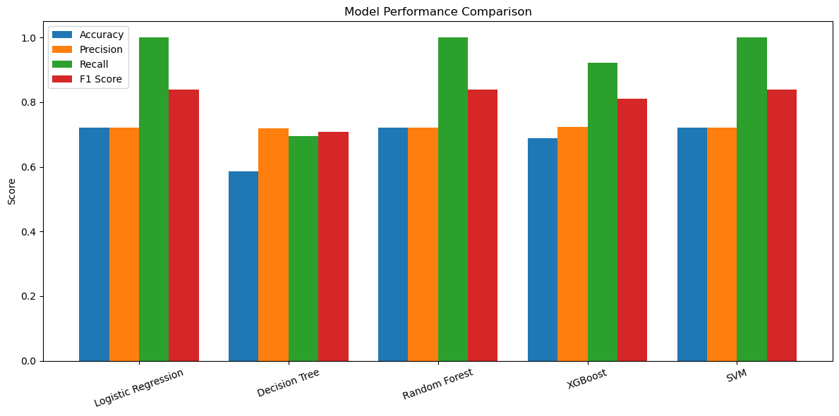
The chart compares the performance of five machine learning models—Logistic Regression, Decision Tree, Random Forest, XGBoost, and SVM—across Accuracy, Precision, Recall, and F1 Score. Most models show similar accuracy and precision (around 0.70–0.72), indicating comparable overall classification performance. However, recall is the key differentiator, with Logistic Regression, Random Forest, and SVM achieving perfect recall (1.00), meaning they successfully identify all patients who are likely to be readmitted, while XGBoost performs slightly lower and Decision Tree performs the weakest. The F1 scores confirm that Random Forest and SVM provide the best balance between precision and recall. Overall, the results suggest that ensemble models and SVM are the most effective, particularly in a healthcare context where capturing all high-risk patients is critical, even at the cost of some false positives.

Slide 9
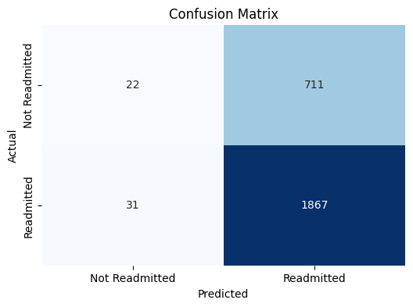
This confusion matrix reveals that the model is quite effective at identifying readmitted patients, with a high recall rate. However, it also indicates that improvements could be made to decrease the number of false positives and improve the model's precision. The overall balance between precision and recall, as represented by the F1 score, suggests that the model can be useful in high-risk healthcare environments where the goal is to minimize missed readmission cases while managing false positives effectively.

Slide 10
Summary
This project focuses on predicting which patients are likely to be readmitted to the hospital within 30 days after discharge. Using patient data such as age, medical history, laboratory results, and medication information, multiple machine learning models were developed to identify high-risk individuals early, enabling timely intervention.
The results show that Random Forest and SVM are the most effective models, achieving high performance, particularly in recall. This means they are able to identify almost all patients who are at risk of readmission. Although this may result in some false positives, it is acceptable in a healthcare setting where preventing missed high-risk cases is critical.
Further analysis highlights that key variables such as Hemoglobin Level, HbA1c Level, Creatinine Level, Time Since Last Discharge, and Average Systolic Blood Pressure are the most influential clinical factors. In addition, Age, Medication Adherence Score, Length of Stay, Number of Medications, and Socioeconomic Risk Score also play an important role, demonstrating that both medical and socio-economic factors contribute to readmission risk.
Overall, the findings indicate that hospital readmissions are driven by a combination of clinical condition, treatment management, and patient demographics. This supports the need for a holistic, data-driven approach to patient care, allowing healthcare providers to proactively identify high-risk patients, improve outcomes, and reduce unnecessary hospital readmissions.

